Slide 1

MATTHEW NICHOLAS LENGKEY
01
TRENDING YOUTUBE VIDEO STATISTICS (US)
DATA ANAYLSIS
September 2022

Slide 2
02
KEY POINTS
Background
Problem Statement
Data Overview
Data Visualization & Analysis
Conclusion
Recommendation
OVERVIEW

Slide 3


03
BACKGROUND

Slide 4
A make up company called X has just launched their latest blush on products. The company has a marketing plan in order to increase their sales on their new product in the U.S. especially for young people.
Therefore, the company wants to conduct their marketing campaigns through the social media, specifically YouTube since YouTube has a huge market for the company to do their marketing campaign
04

Slide 5
PROBLEM STATEMENT
05
How to promote the company's latest blush on products through YouTube platform?
Youtube Ads
Endorsement

Slide 6

06
DATA OVERVIEW

Slide 7
Overview
CONSISTS OF TRENDING VIDEOS FROM 2017-2018 IN THE UNITED STATES
There are:
41K+- Data
16 Columns
07
Now:
41K+- Data
22 Columns

Slide 8
08
GENERAL DATA
DATA VISUALIZATION
Anaylsis

Slide 9
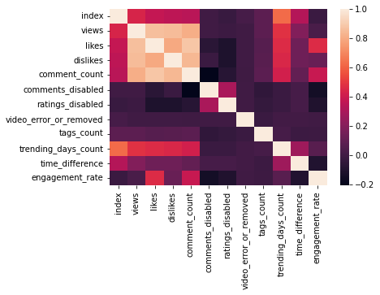
09
There is a strong correlation of likes-dislikes-comment_count-views (>0.7)
There is a correlation between engagement_rate and likes and comment_count although it is not that strong
(0.4~)

Slide 10
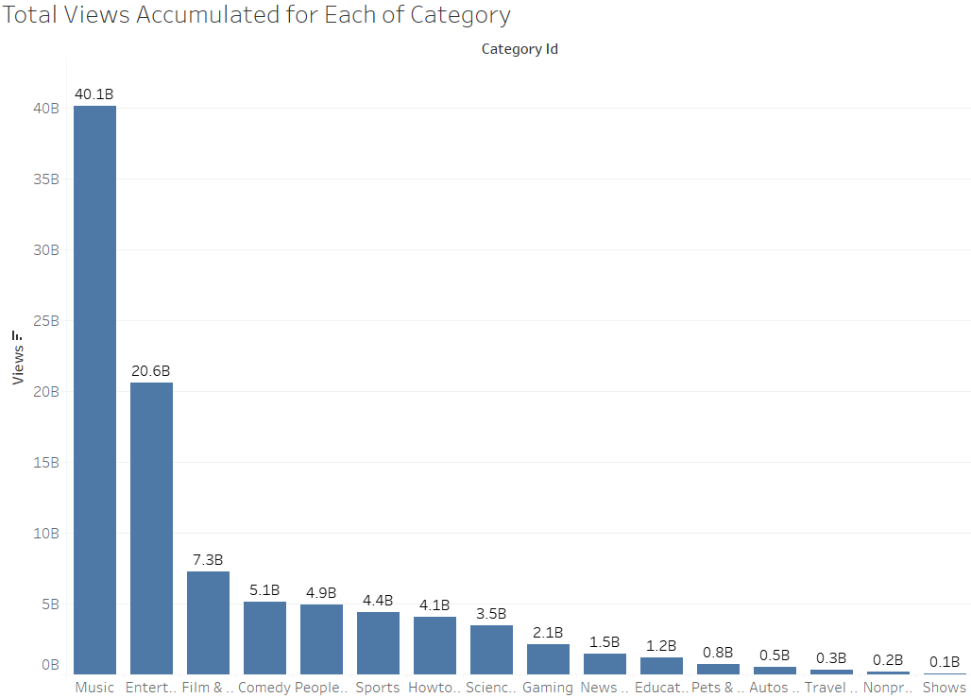
10

Slide 11
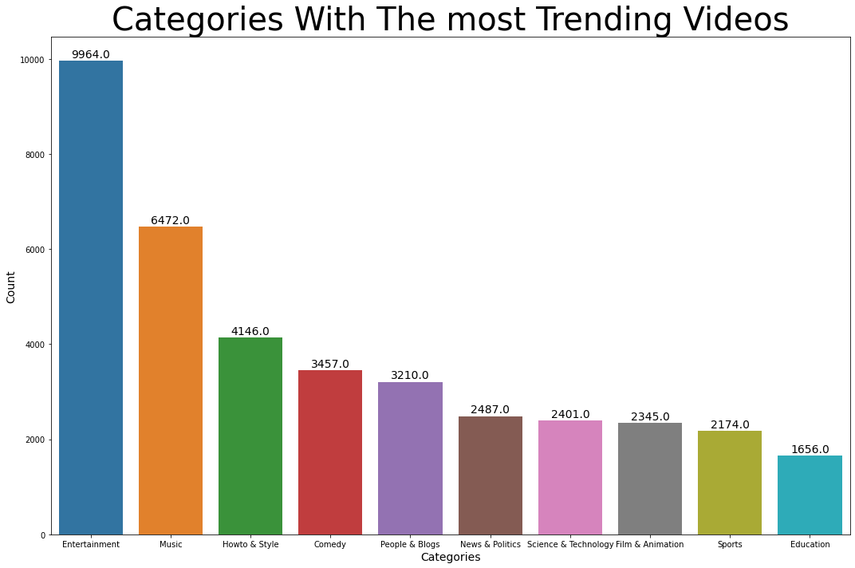
KC
11

Slide 12
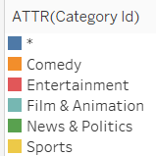
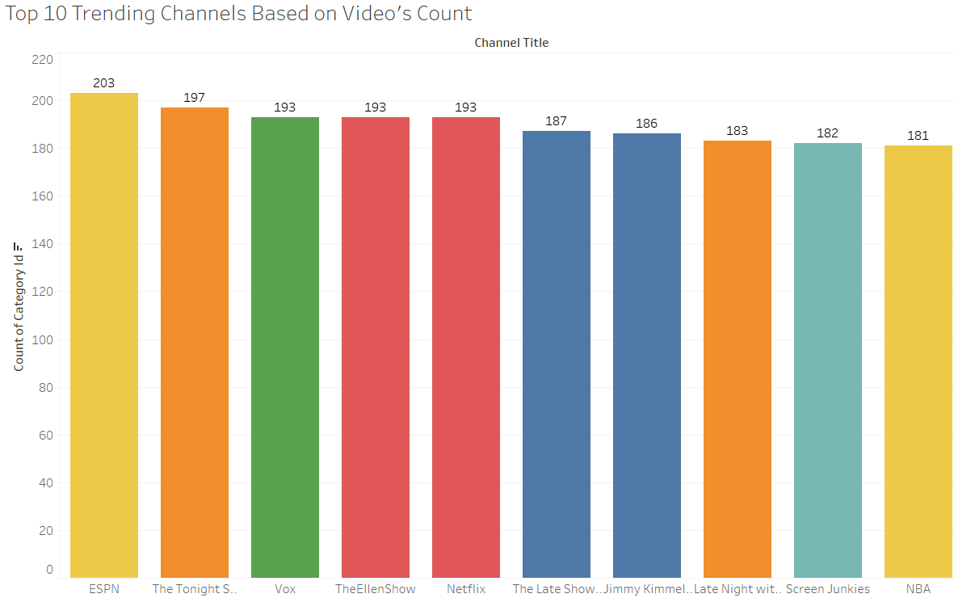
12

Slide 13
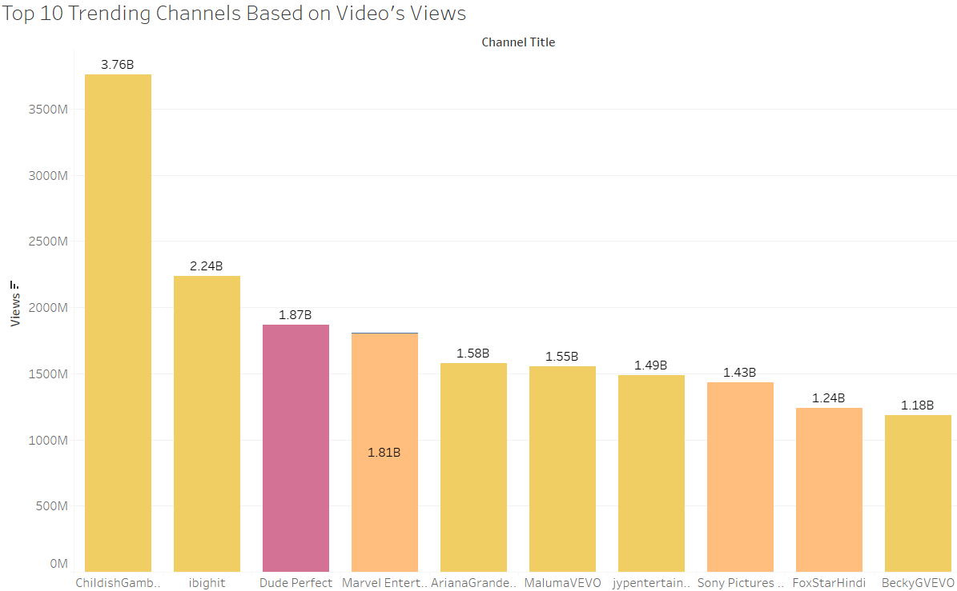
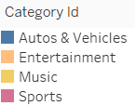
13

Slide 14
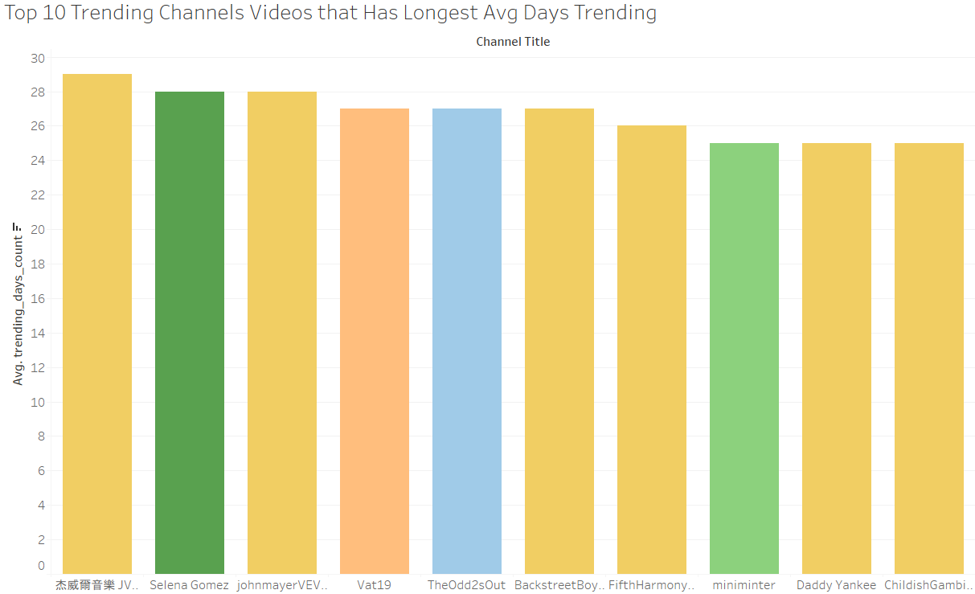
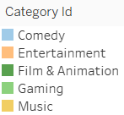
14

Slide 15
Conclusion
15
General Overview
Seeing the general overview data clearly can be seen that there are the top 2 categories that dominated the YouTube 2017-2018's trending section based on these charts:
Categories With the Most Trending Videos
Total Views Accumulated for Each Category
Top 10 Trending Channels Based on Views
Top 10 Trending Channels Videos that Has Longest Avg Days Trending
Top Categories: Music and Entertainment
Both categories have the highest views accumulated and the most video listed on the YouTube trending page. Film & Animation also may become a potential category to do the marketing campaign.

Slide 16
16
SPECIFIC DATA
DATA VISUALIZATION
Analysis

Slide 17
What's the difference?
17
It is already filtered
1-17 days time difference
Categories:
Howto & Style
People & Blogs
Entertainment
Tags:
"beautiful"
"make up",
"beauty"
"blush on"
4.9K+- DATA
Notes:
Because the company is a Makeup company, so we try to specialize datas that are needed for the company to execute their marketing campaign on their new blush on product. It's better to give the advertisement to a more segmented market.

Slide 18
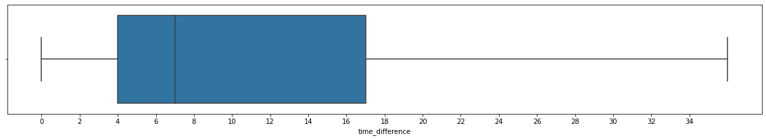
Time Difference
18
It can be seen that the most trending videos have a time span of 4-17 days since the time the video was published. An average of 7 days the video time distance for trending then the number of trending videos decreases if the video time distance for trending is getting longer
Notes:
Because the company is a Makeup company, so we try to specialize datas that are needed for the company to execute their marketing campaign on their new blush on product. It's better to give the advertisement to a more segmented market.

Slide 19
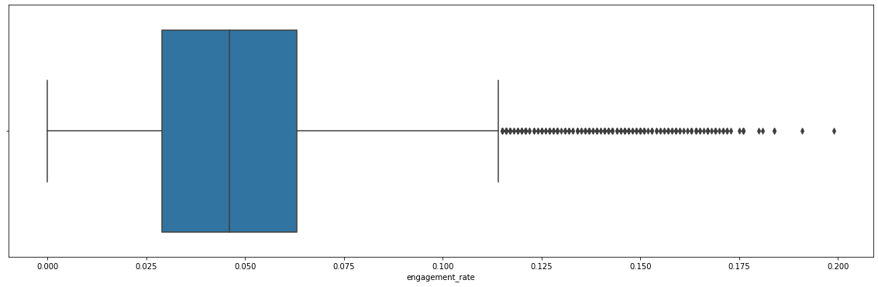
Engagement Rate
19
(Like+ Comment)/View
Usual range of engagement rate lies within 2.9%-6.3% with the median of 4.6%. The higher it is the better
Notes:
Because the company is a Makeup company, so we try to specialize datas that are needed for the company to execute their marketing campaign on their new blush on product. It's better to give the advertisement to a more segmented market.

Slide 20
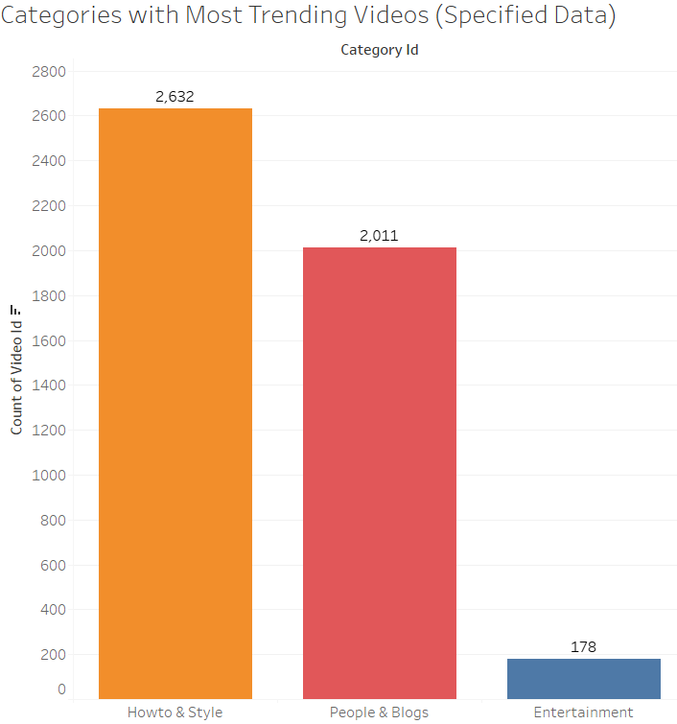
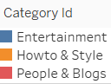
20

Slide 21
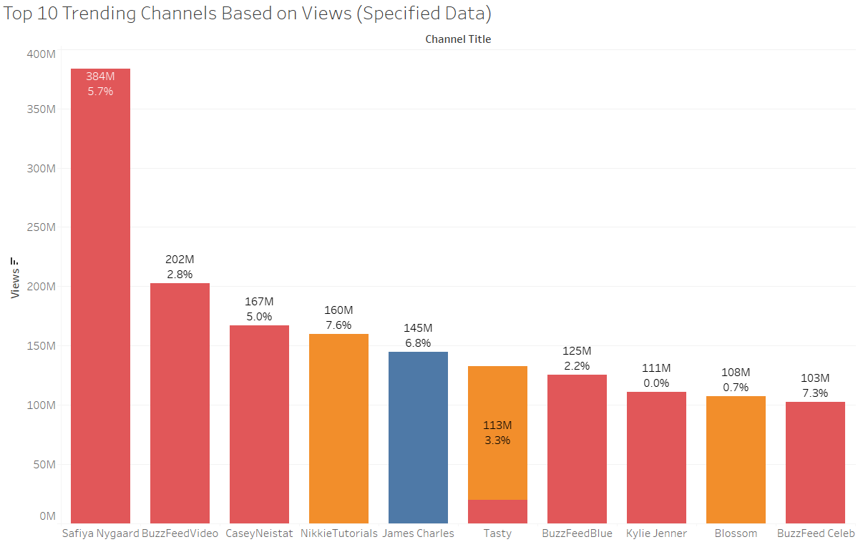
21

Slide 22
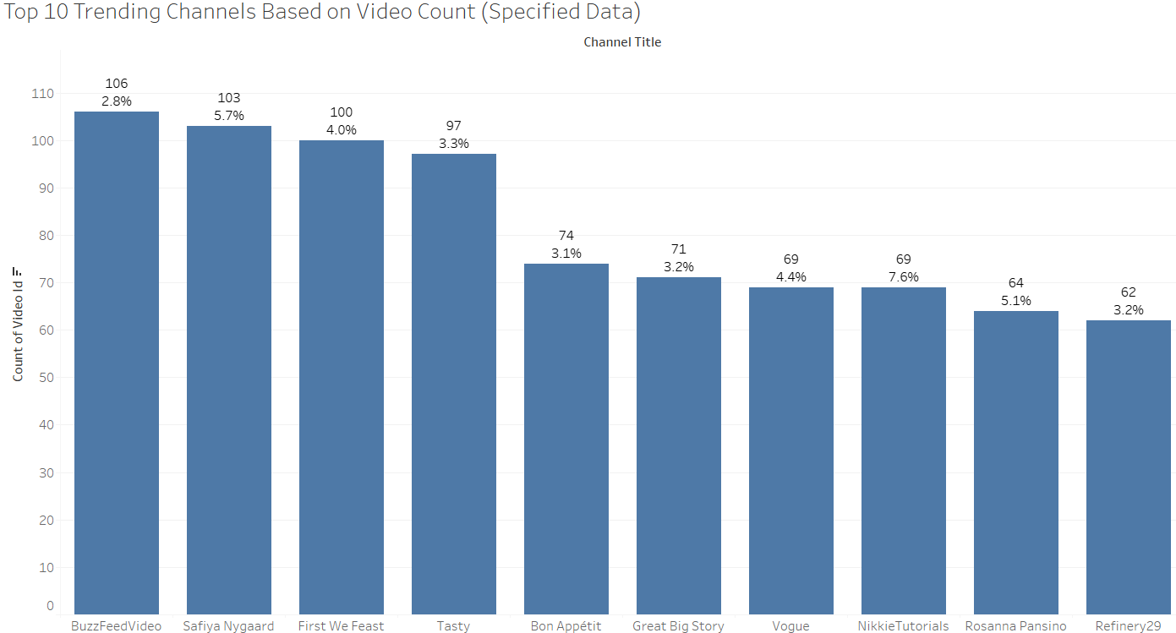
22

Slide 23
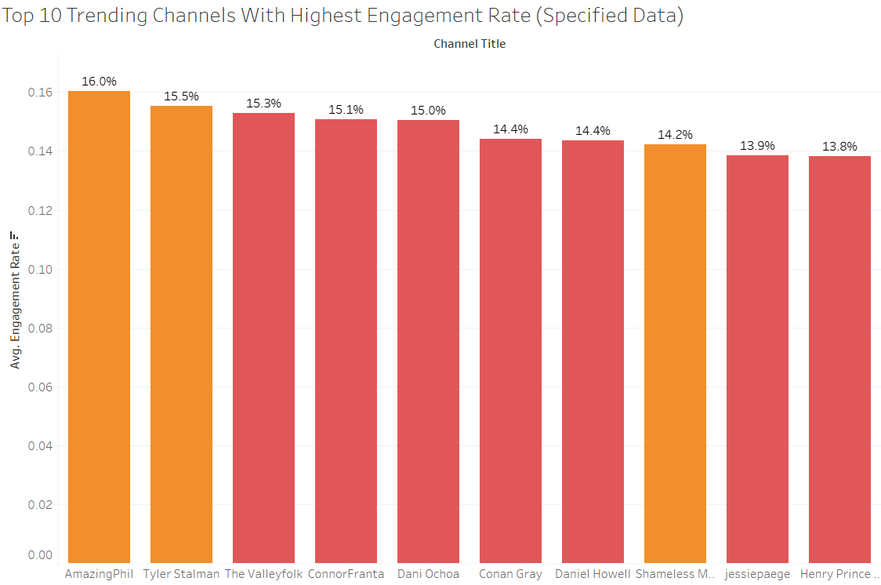
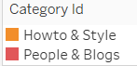
23

Slide 24
24
CONCLUSION

Slide 25
Conclusion
25
Specific Overview
Seeing the specific overview data, the trending days are set to 1-17 days because the company wants to do the marketing on their latest product. So it is better to set the time to the usual time when the video can be trending. Around 1-17 days after the video was released, the Howto & Style category has the most videos listed on the YouTube trending page, followed by People & Blogs, and Entertainment.

Slide 26
26
RECOMMENDATION

Slide 27
Recommendation
27
General Data & Specific Data Combination
Based on our analysis, the company can do two types of a marketing campaigns on YouTube
1. Using Youtube Ads
YouTube Ads through general data
YouTube Ads through specific data
2. Using endorsement for some of the YouTube channels that have good statistics

Slide 28
Recommendation
28
Using General Data: Entertainment & Music is the Top Categories
Youtube Ads
I suggest the YouTube Ads portion in the General Data should not be to much even though it's also necessary to raise thier brand awareness on the general society. It can be done by specifying Entertainment and Music categories on the Youtube Ads (25-35% portion of YouTube Ads)
Endorsements
It's also possible to give endorsements to some Music/Entertainment channels that has a good statistics. Maybe the product will be covered at a music video, or the new product will be featured on an Entertainment category videos. But I suggest to more focus on the specific data.

Slide 29
Recommendation
29
Using Specific Data:
Youtube Ads
For the YouTube Ads matter, the company can give the big portion of the YouTube Ads on this specific data. We assumed the audience of the targeted marketing is for people who know enough about the beauty industry, which usually lies on these categories and tags. (65-75% portion of YouTube Ads)
Endorsements
It is also recommended to include endorsement in the company's marketing campaign. Using the specific data above, we can see that there are potentials YouTube channel that can be asked to do endorsements on the company's new blush on product.

Slide 30
Recommendation
30
Potential Talents
Safiya Nygaard. She's a makeup content creator
2nd highest video count (103 Videos)
The most accumulated views (383,655,347) among those three categories
Average ER(5.8%).
NikkieTutorials. She's a makeup artist
Seventh highest video count (69 videos)
Average ER (7.6%)
James Charles. He's an artist
Fifth most accumulated views (144,866,943)
Rosanna Pansino. She's a makeup content creator
Seventh highest video count (64 videos)
Average ER (5.1%)

Slide 31
Recommendation
31
Potential Talents
*If the company wants to do endorsement to individual YouTube channels, better to request in-depth YouTube statistics for each channel*. Females are recommended
Else, try to pick YouTube channels that are based on a high Engagement Rate displayed above if the company doesn't want to spend too much cost on the marketing budget. (because not every youtube channel that has a high ER on average has a big audience compared to charts that display top video count/views)
The company can explore & modify the datasets filter for further research based on the specific data if they want to search for more talents (e.g: make it top 20 on the chart, add more tags, etc.)

Slide 32

32
THANK YOU

